Slide 1
Engineering Clinics

Slide 2
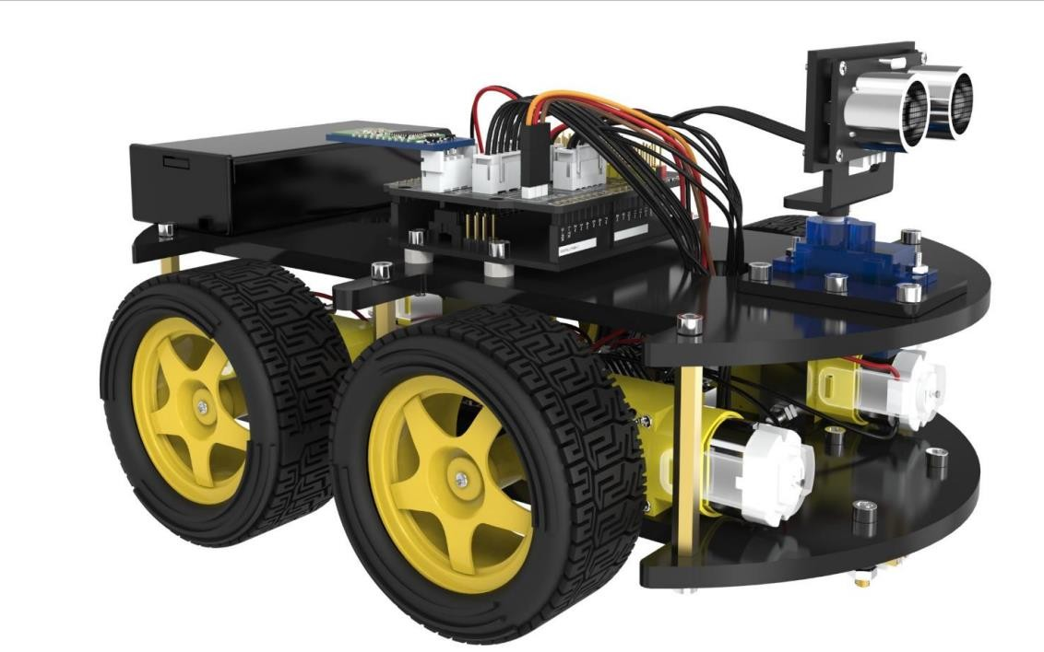
Smart Robot Car Using Arduino

Slide 3

PROJECT GUIDE
PROF. NEERAJ KUMAR MISHRA
Ph.D under TEQIP-II, PGD (ML & AI from NIT Warangal), Associate Professor at VIT-AP University, ECE, Editorial Board Member of ACTA SCIENTIFIC , Quantum Computing | | Reversible Logic | | Low Power VLSI | | AI & ML

Slide 4


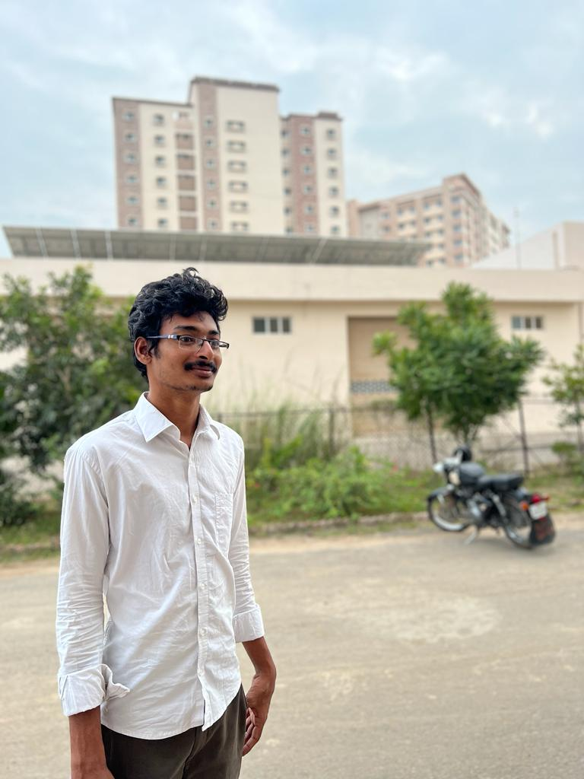



Meet our team
Arumulla Yaswanth Reddy
Kakumanu Srimani
Damarla Bhuvan Sri Sai
20BES7010
20BCD7133
20BCD7096
Nuthalapati Jashvika
Kandukuri Pranavi
Chandini Kollati
20BCD7115
20BCR7104
20BCE7379

Slide 5


Agenda
A
Introduction
Parts
Problem Definition
Circuit Diagram
Codes in Appendix
3D-Video
Reference

Slide 6
Introduction
SMART ROBOT CAR USING ARDUINO
An impressive work combining different solutions to the real world problems! The Smart Car has features like Ultrasonic Range finder for collision avoidance and semi-autonomus navigation; Optical sensors for line following navigation; Bluetooth connection for remote control operation; and an Infrared Remote Control.

Slide 7
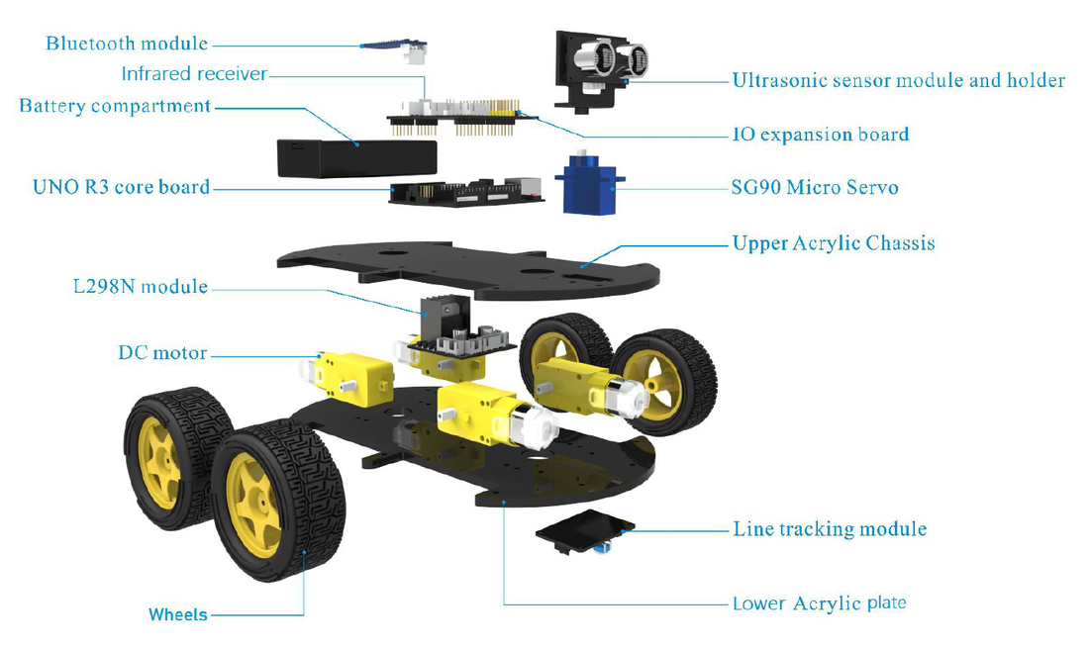
Parts
F
DC motors
L298N motor driver
Arduino UNO
Sensor shield
SG90 Micro Servo
Ultrasonic sensor & holder
Line tracking module
Bluetooth module
Infrared receiver
Rechargeable Battery
Wheels

Slide 8
Smart Robot Car – Initial Test
“
”
The Smart Robot Car has the following functions:
1. Bluetooth Mode
2. Line Tracking Mode
3. Obstacle-avoidance Mode
​4. IR-Remote Control Mode

Slide 9
Problem Definition
This project is aims at developing Arduino based smart robotic control to provide a better solution to society.
In this modern digital world, everyone is moving towards automation Robotics allows automation where machines perform a well-deﬁned step safely and productively, in autonomous or partial autonomous manners.
A number of robot car bases are available for just such a project. These inexpensive bases are generally made of acrylic and come complete with a set of small DC motors.

Slide 10
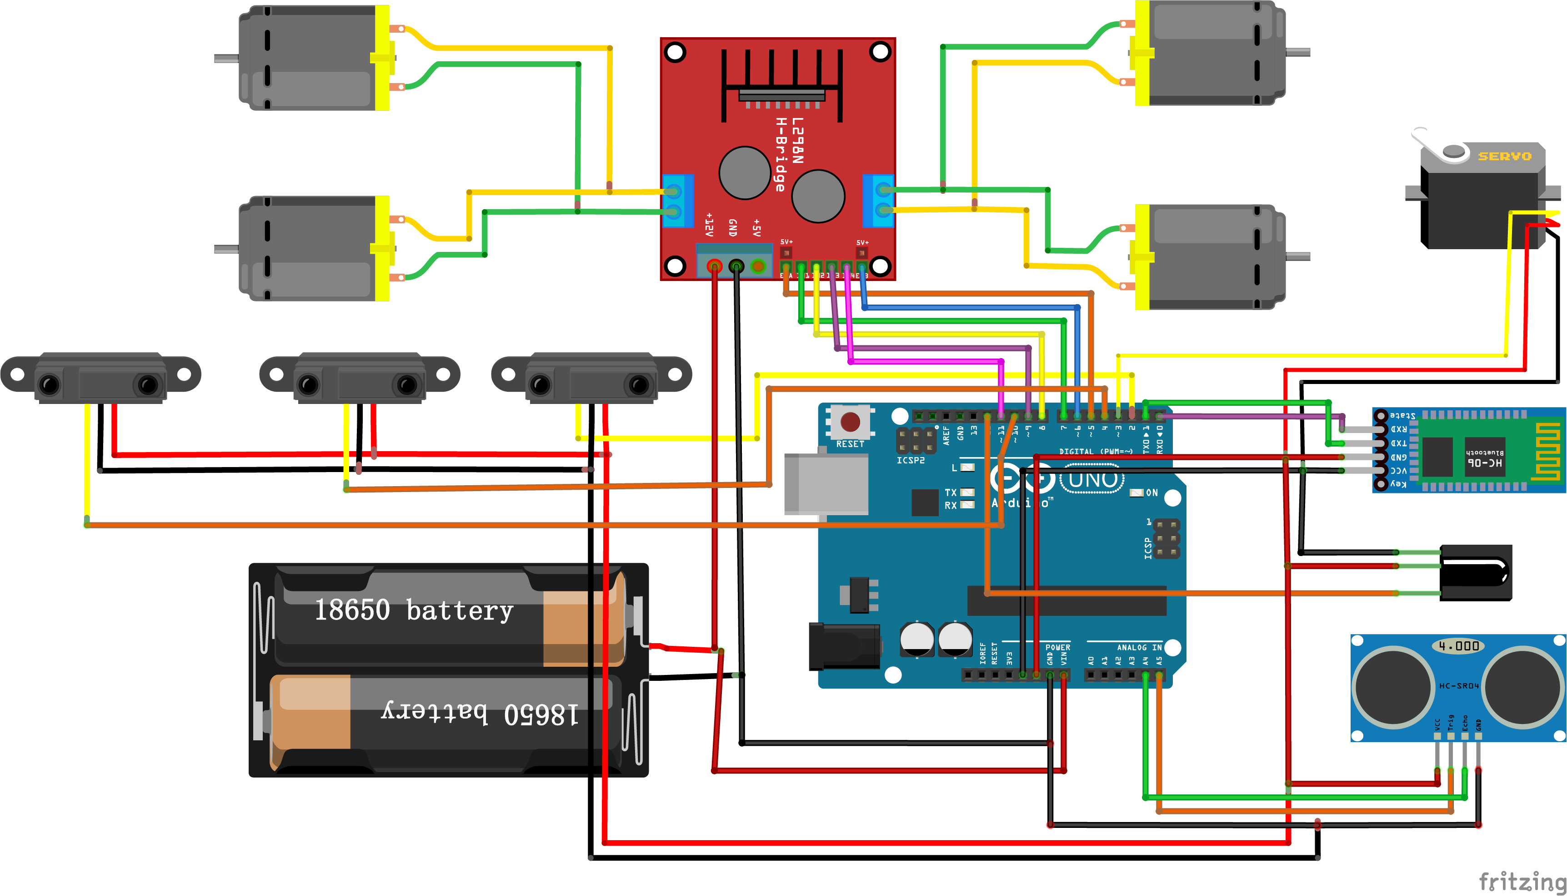
Circuit Diagram

Slide 11
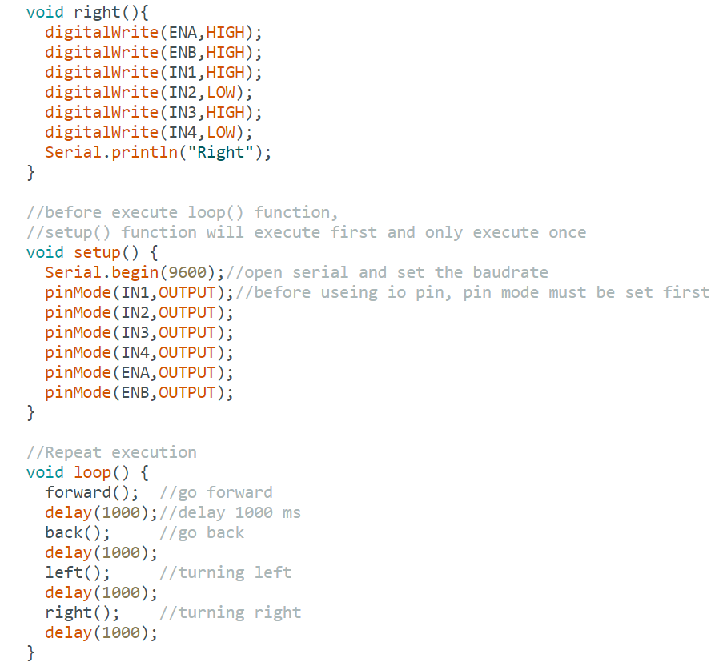
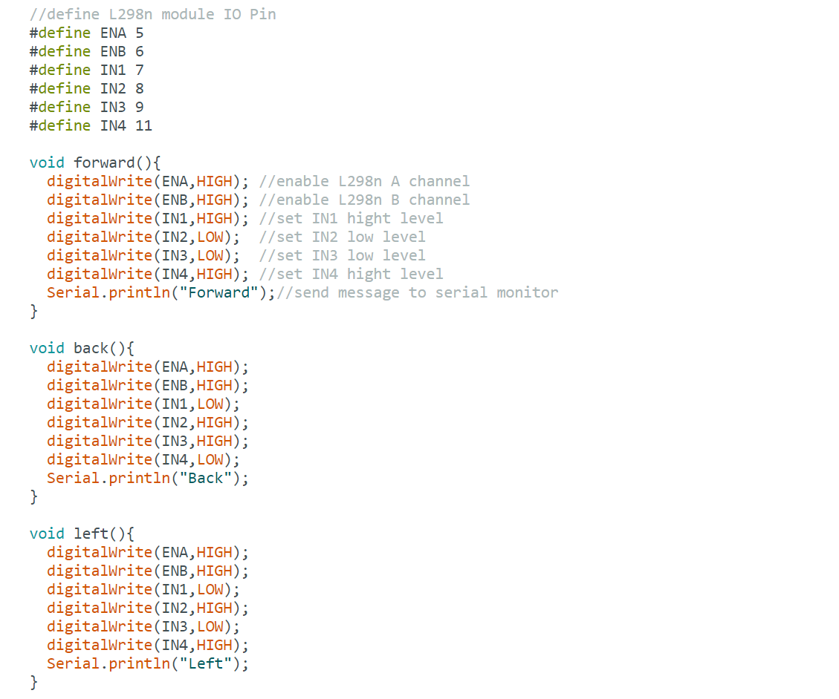
Codes in Appendix
AUTO_GO.ino

Slide 12
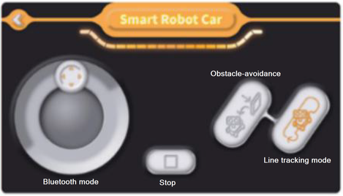
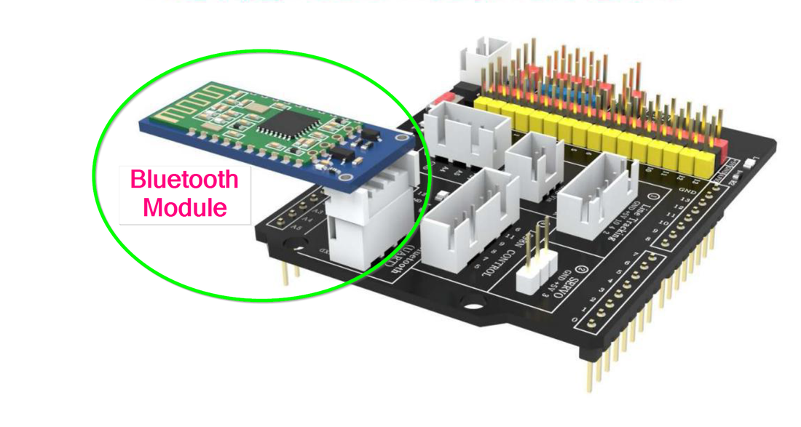
Bluetooth Mode
Once you verified the assembly and motor operation of the Smart Car using the "Auto Go" sketch, you can use the "Bluetooth Car" Sketch form the downloaded files to perform the Bluetooth operational test. First, install the Bluetooth App, BLE Tool", on your smartphone from Google Play Store for Android or from App Store for an iPhone.
Then, upload the "Bluetooth Car" Sketch to your Smart Car Arduino board. A copy of the "Bluetooth Car" Sketch is also provided here. Connect the Smart Car to the computer.
Disconnect the Bluetooth module
Upload the downloaded Arduino sketch, “bluetooth_car.ino” to your Smart Car.
Disconnect the programming cable.
Reinstall the Bluetooth module.
Position the Smart Car on a flat surface and turn the power switch to ON
Open the “BLE Tool” App on your smartphone.
Pair the Smart Car Bluetooth with the App.
Inside the “Rocker Control Panel” of the App, use the Bluetooth mode joystick control to move the car forward, back, left, right, and Stop to test the Bluetooth operation.

Slide 13
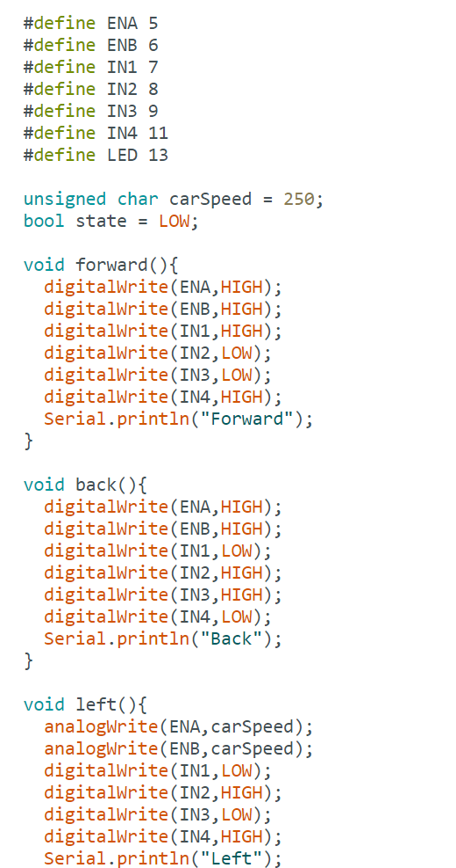
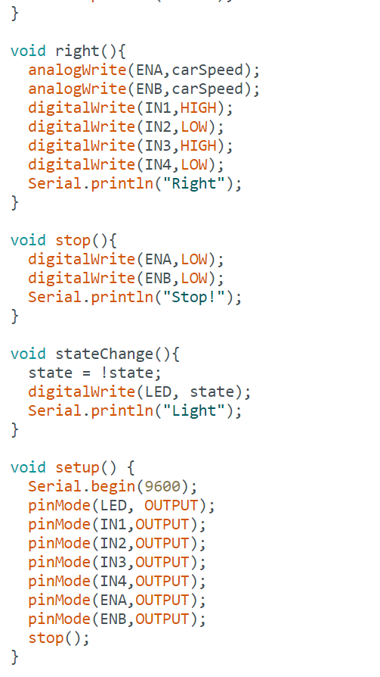
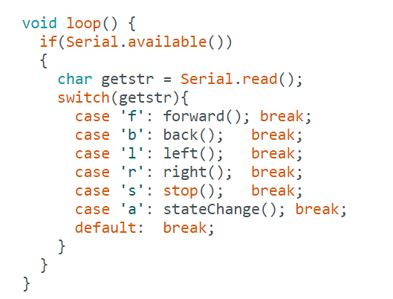
bluetooth_car.ino

Slide 14
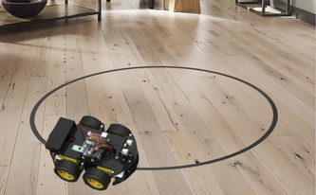
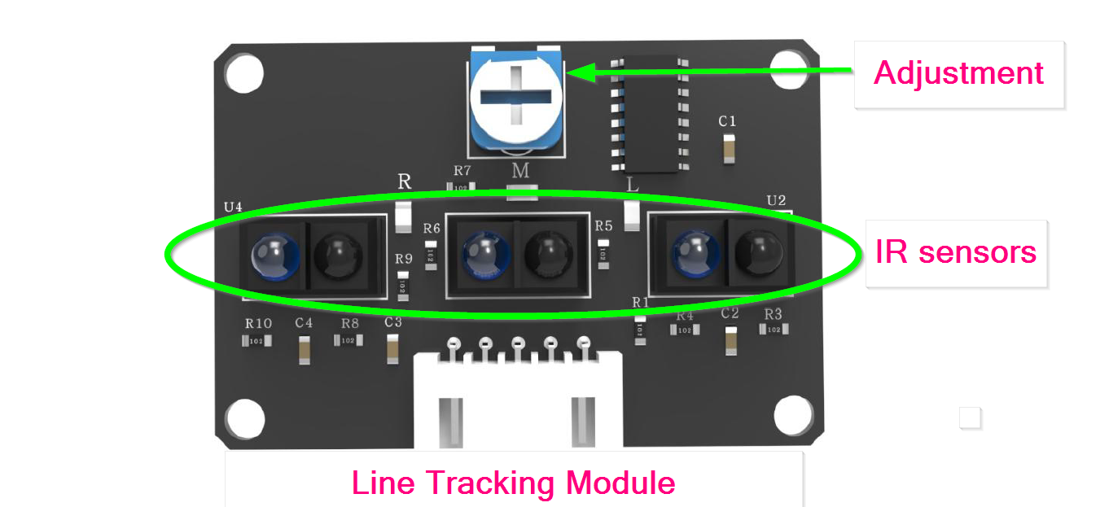
Line Tracking Mode
In order to test the Line Tracking Module, download the Arduino sketch, "Line_tracking_car.ino" to your Smart Car and position the Smart Car on the closed path. Turn on the power switch and then the Smart Car will start to navigate along the black line until you stop the car by turning the power switch off. The Arduino sketch is also provided here for convenience. ​Disconnect the Bluetooth module
Upload the downloaded Arduino sketch, “Line_tracking_car.ino” to your Smart Car.
Disconnect the programming cable.
Reinstall the Bluetooth module.
Position the Smart Car on the closed path (black tape), turn the power switch to ON
Open the “ BLE Tool” App on your smartphone, if you haven’t done it so.
Pair the Smart Car Bluetooth with the APP.
Inside the “Rocker Control Panel” of the App, select the "Line Tracking" button and observe the Smart Car navigating along the closed path. Enjoy.

Slide 15
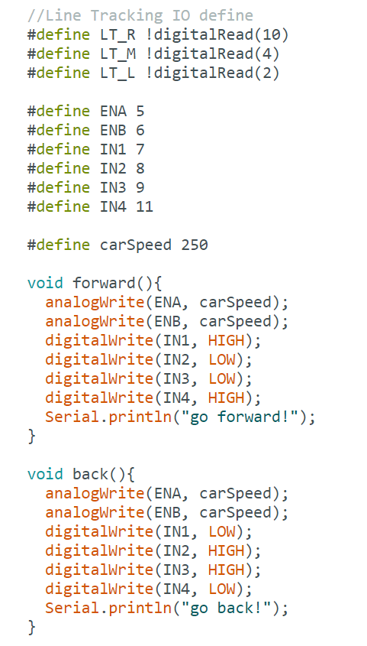
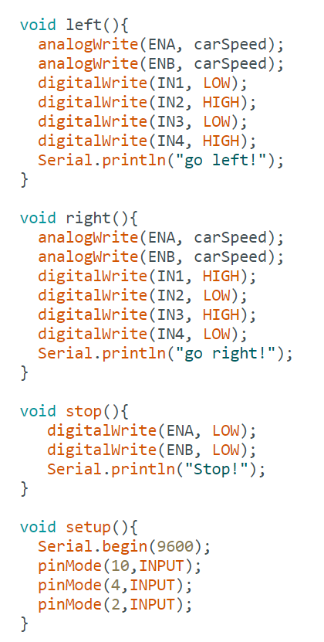
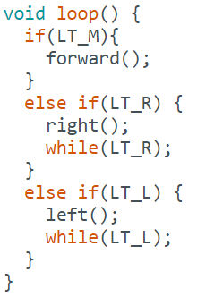
Line_tracking_car.ino

Slide 16
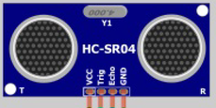
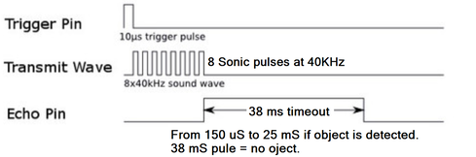
Obstacle-Avoidance Mode
The ultrasonic sensor has four pins: VCC – This is the 5-volt positive power connection. TRIG – This is the “Trigger”, an input for the pulse we will be sending from the ultrasonic transmitter. ECHO – This is an output that sends back the received pulse. GND – The Ground connection.
int ultrasonic_test(){ digitalWrite(Trig, LOW); delayMicroseconds(2); digitalWrite(Trig, HIGH); delayMicroseconds(10); digitalWrite(Trig, LOW); float distance = pulseIn(Echo, HIGH); distance = distance / 58; }
To obtain the distance, measure the width (Ton) of Echo pin. Time = Width of Echo pulse, in uS (micro second) - Distance in centimeters = Time / 58 - Distance in inches = Time / 148 - Or you can utilize the speed of sound, which is 340m/s The ultrasonic module can be tested using Arduino microcontroller and the following sketch function.

Slide 17
Obstacle Avoidance – Operation The principle of obstacle or collision avoidance is as simple as “if – else if – else” statement in C++ or any other programing languages. The ultrasonic sensor module will detect the distance between the car and an obstacle in front of it and sending the data to the microcontroller. Then, the microcontroller sends a corrective action to the smart car and this process continues repeatedly. The algorithm follows the following sequence.Ultrasonic sensor measures the distance to the nearest object until obstacle detected.
Stop the car.
Measure the distance to the right and left of the Smart Car.
Turn the car in the direction that you measure the longest distance.
Move forward.
Upload the downloaded Arduino sketch, “Obstacle_Avoidance_Car.ino” to your Smart Car.
Disconnect the programming cable.
Reinstall the Bluetooth module.
Position the Smart Car on a flat surface, turn the power switch to ON
Open the “BLE Tool” App to your smartphone, if you haven’t done it on the previous section.
Pair the Smart Car Bluetooth with the App.
Inside the “Rocker Control Panel” of the App, select obstacle avoidance and enjoy the autonomous navigation in action.

Slide 18
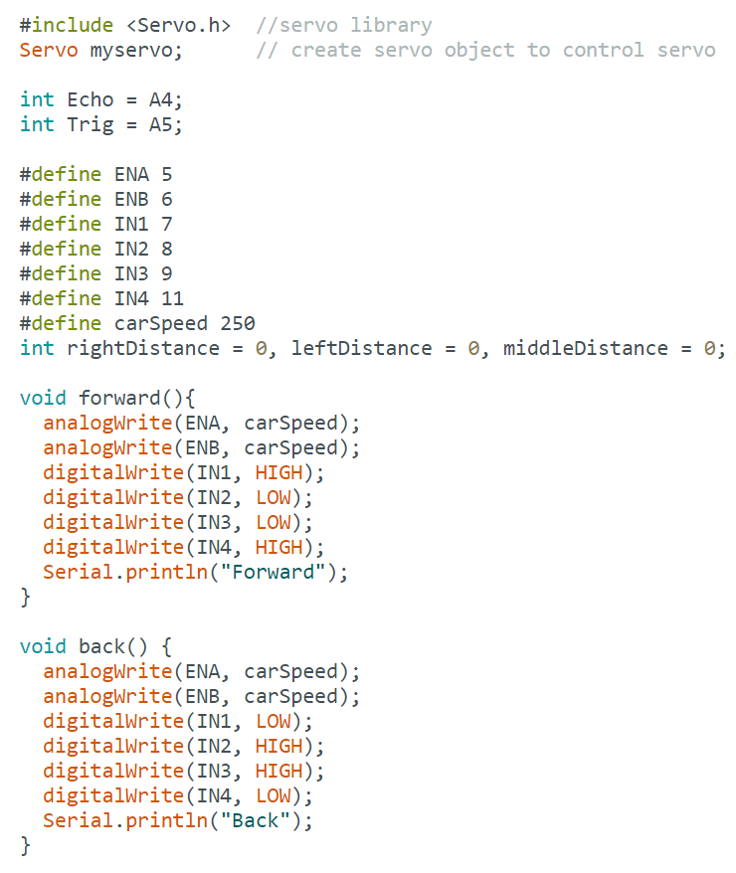
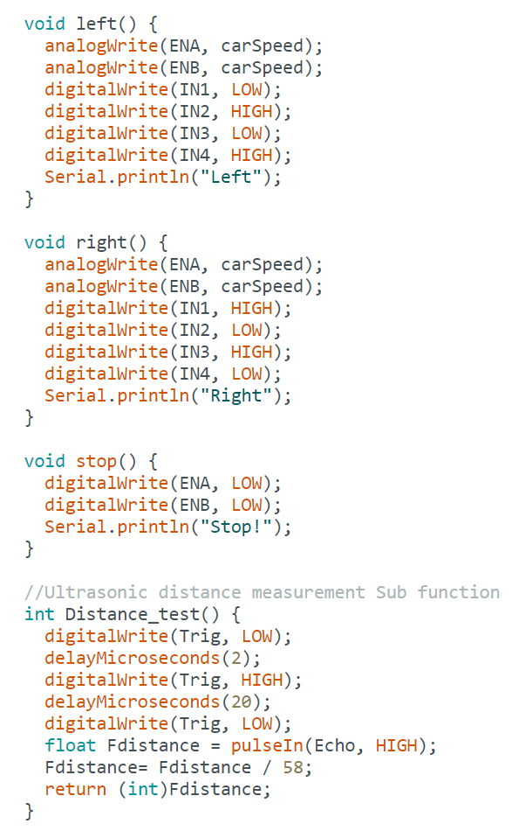
Obstacle_Avoidance_Car.ino

Slide 19
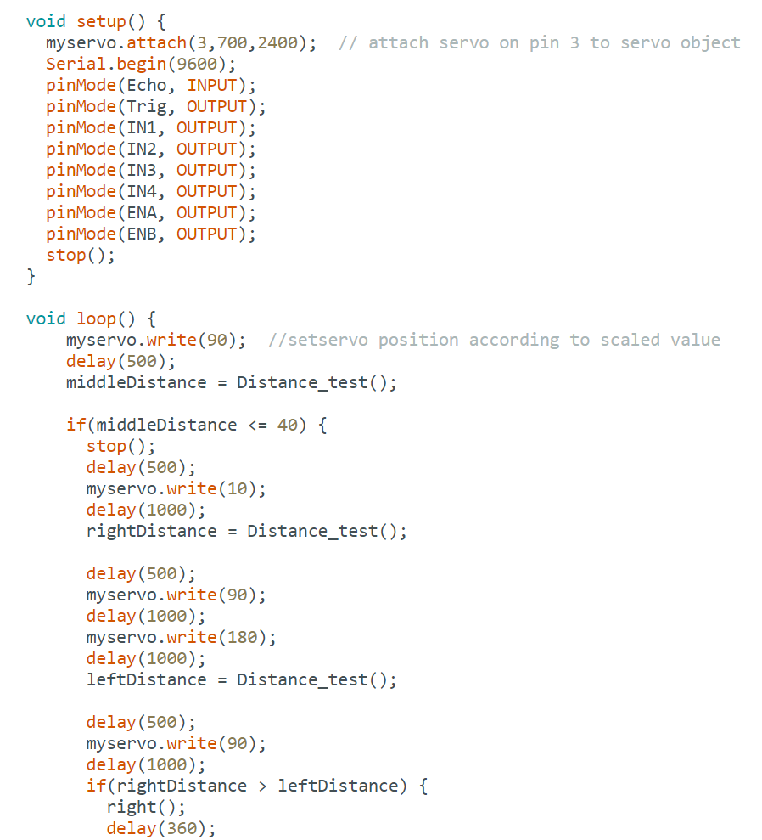
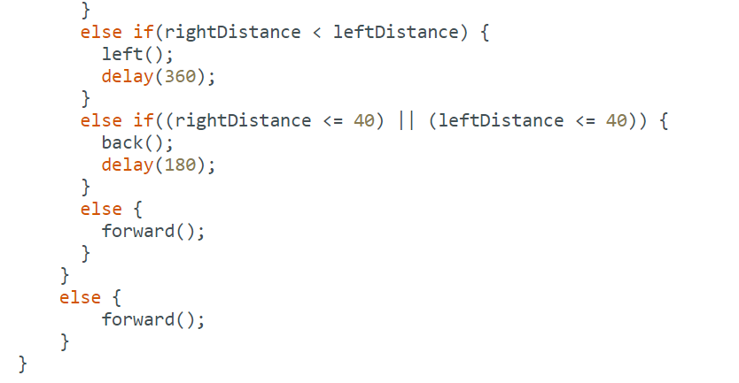

Slide 20
3D-Video
3D VIDEO
https://drive.google.com/file/d/1A6Up0yYtof8j6NiwP9hy5LY1pZkhlrB2/view?usp=share_link
Bluetooth smart Robot car
https://drive.google.com/file/d/15xIaTEJ0iitTXJl593jNsaKOYIkEk3l-/view?usp=share_link
Line Tracking Smart Robot Car
https://drive.google.com/file/d/19TptkaigApa1uHSMcX7lRNyZWdMNC8RA/view?usp=share_link
Obstacle Avoidance Car
https://drive.google.com/file/d/1J58Tdl3vVIYg1RK4mMYCK9bem89Majs6/view?usp=share_link
Infrared Remote Control Car
https://drive.google.com/file/d/1OfQempyMAheJR_98Z7nkb7P0pc1B7pXx/view?usp=share_link

Slide 21
REFERENCE
https://create.arduino.cc/projecthub/samanfern/bluetooth-controlled-car-d5d9ca
https://create.arduino.cc/projecthub/comptek4/ir-remote-control-car-fcb8a5?ref=search&ref_id=Infrared%20Remote%20Control%20Car&offset=1
https://create.arduino.cc/projecthub/chandran0303cn/obstacle-avoidance-bot-using-ir-sensors-08f8e9?ref=search&ref_id=Obstacle%20Avoidance%20Car&offset=1
https://create.arduino.cc/projecthub/SXHXC/smart-face-tracking-robot-car-f23d76?ref=search&ref_id=Line%20Tracking%20Car&offset=5

Slide 22
Thank you
Arumulla Yaswanth Reddy
20BES7010
Kakumanu Srimani
20BCD7133
Damarla Bhuvan Sri Sai
20BCD7096
Nuthalapati Jashvika
20BCD7115
Kandukuri Pranavi
20BCR7104
Chandini Kollati
20BCE7379

